Slide 1
Reading TOFAS Results Finding Trends
For Teachers Sprix Global Strategy Division

Slide 2
This video is for…
Teachers whose students took TOFAS multiple times
- To look at trends on each individual
- To look at trends within a class overtime
- To look at trends within a grade
Thank you for watching this video. This video is for the teachers whose students took TOFAS multiple times throughout their school years. In this
video, you will see how you can analyze the students’ result to improve instruction.

Slide 3
Contents
1. Provided Results
2. Trends on Individuals and in a Class 【Same Level / Same Student】
3. Topics That Bridge Between Level【Different Level / Same Student】
First, I will introduce how to look at students’ trends when students take the same level test multiple times.
Then, I will introduce how to analyze their results when students take different levels.

Slide 4
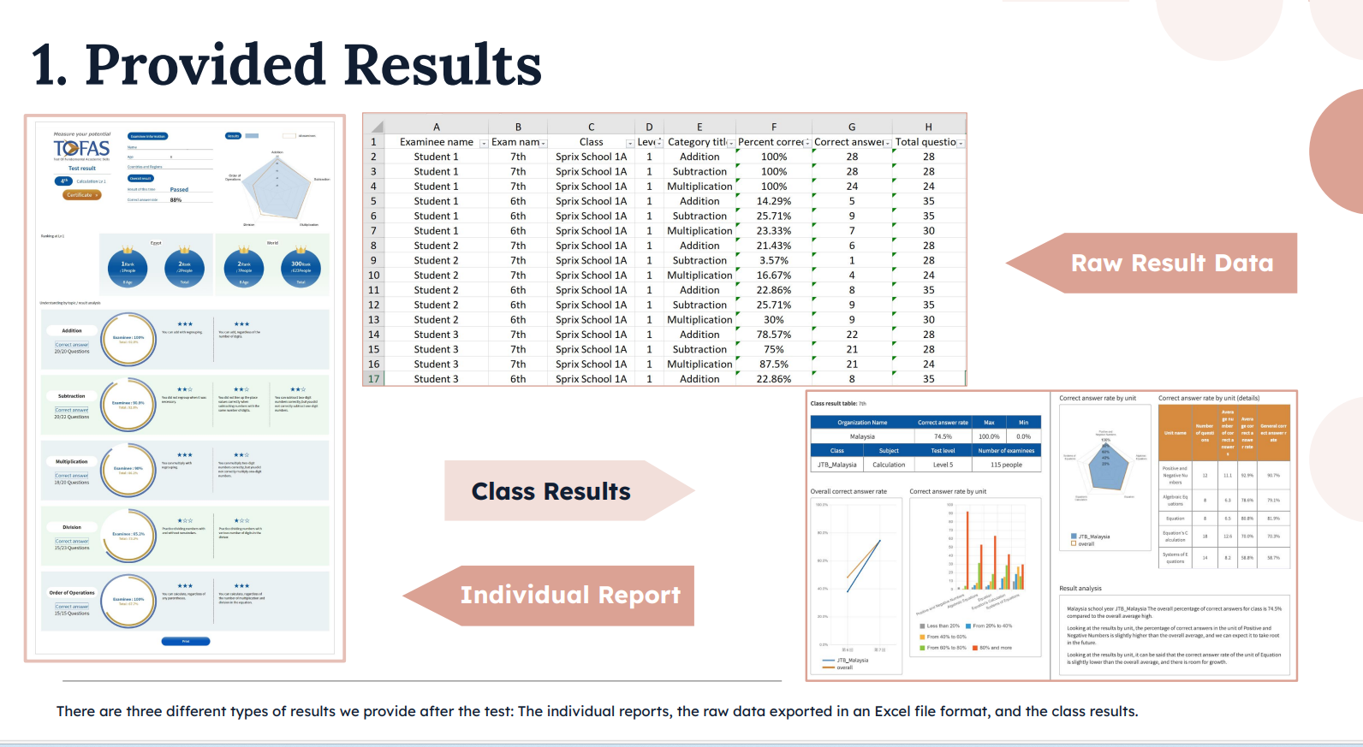

Slide 5
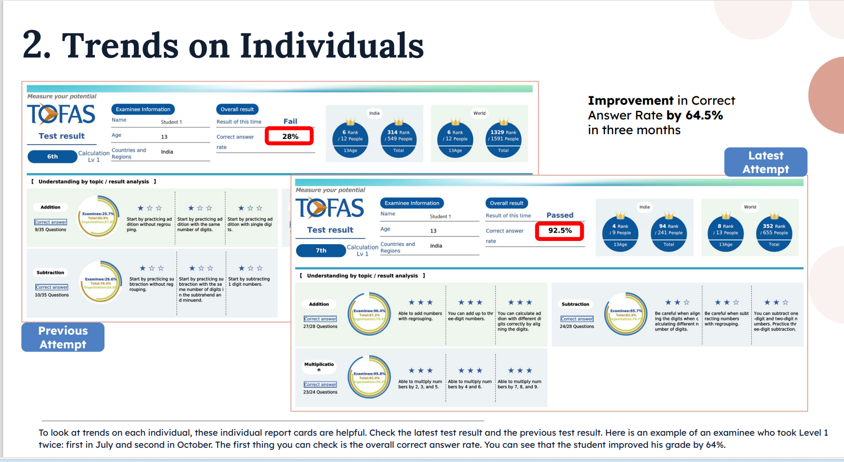

Slide 6
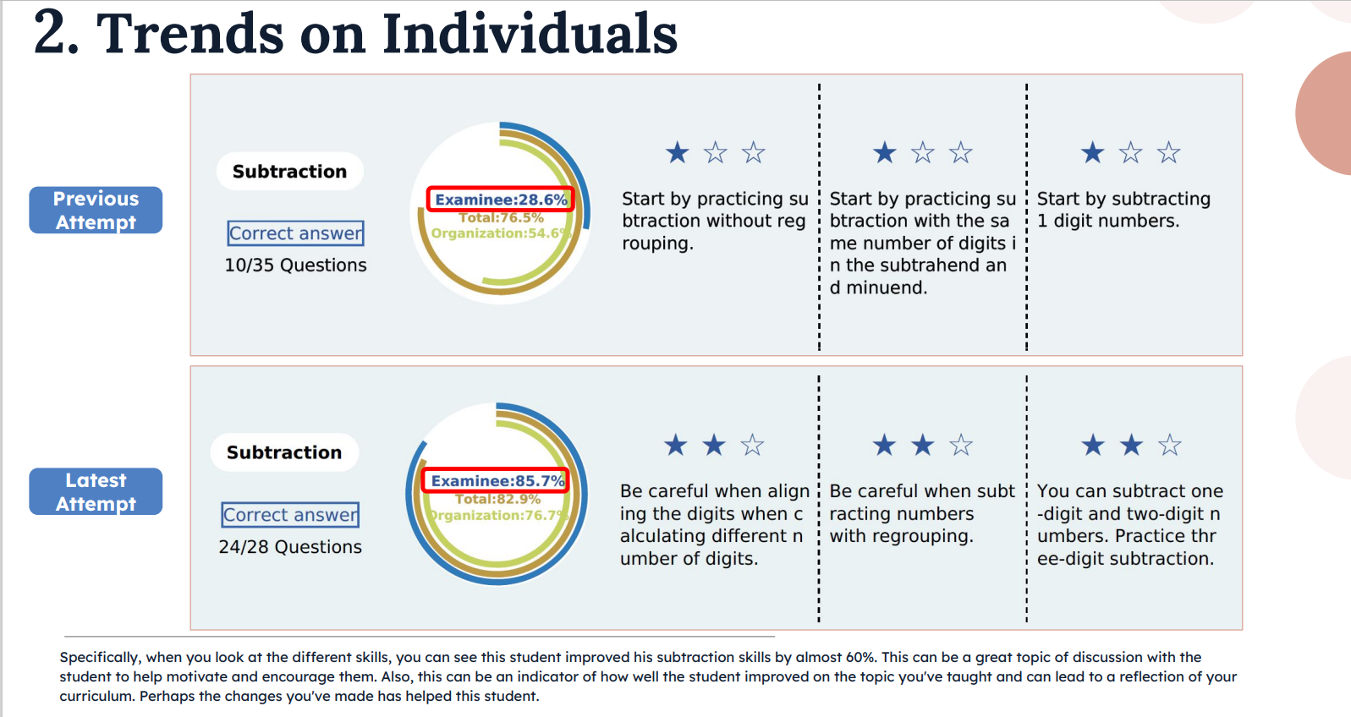

Slide 7
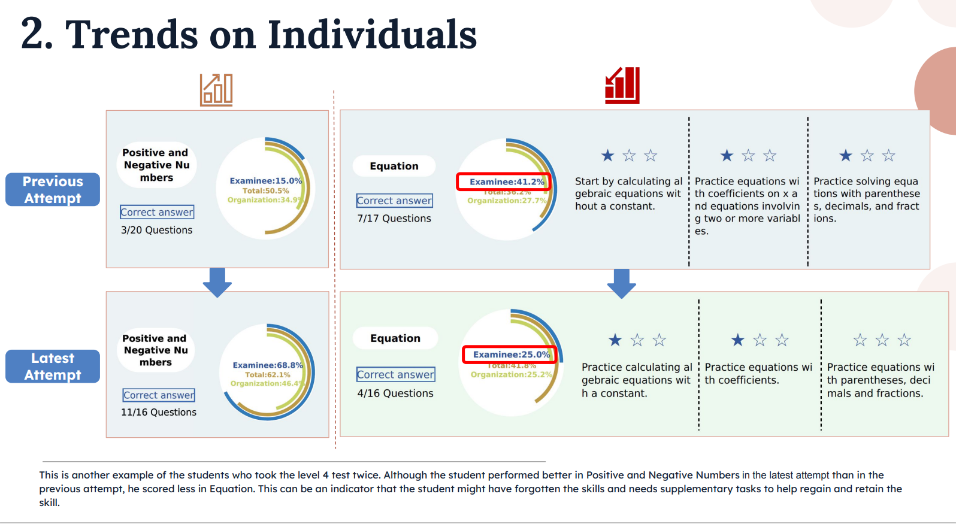

Slide 8
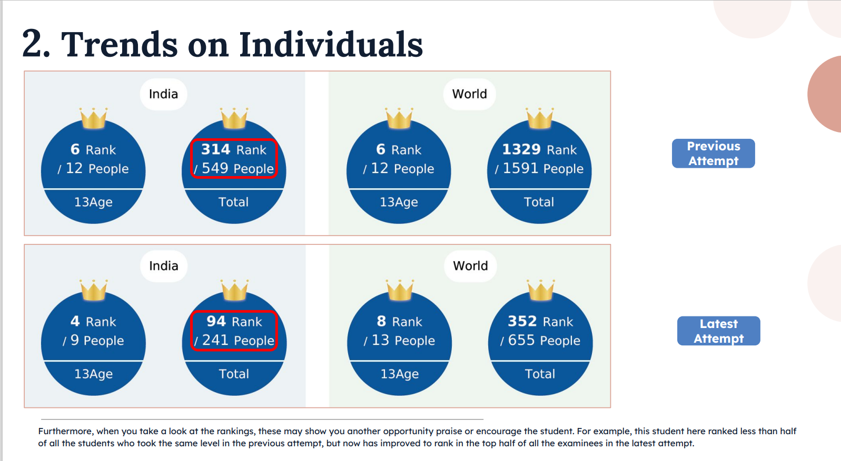

Slide 9
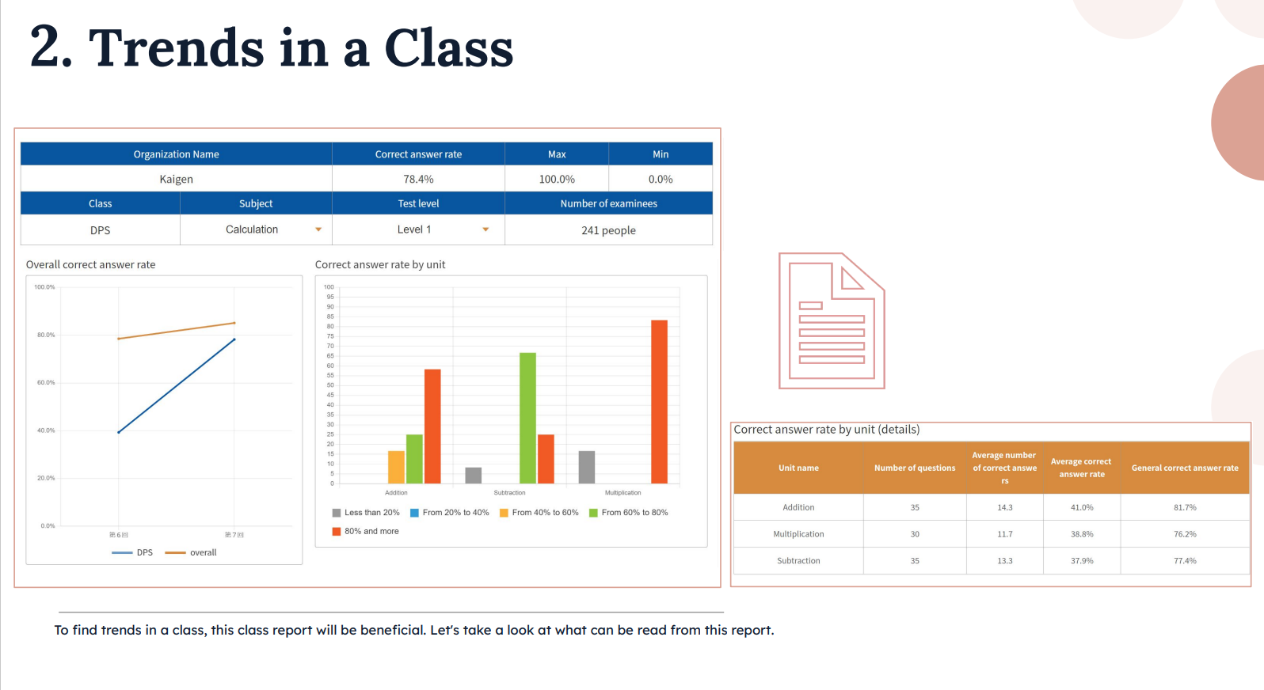

Slide 10
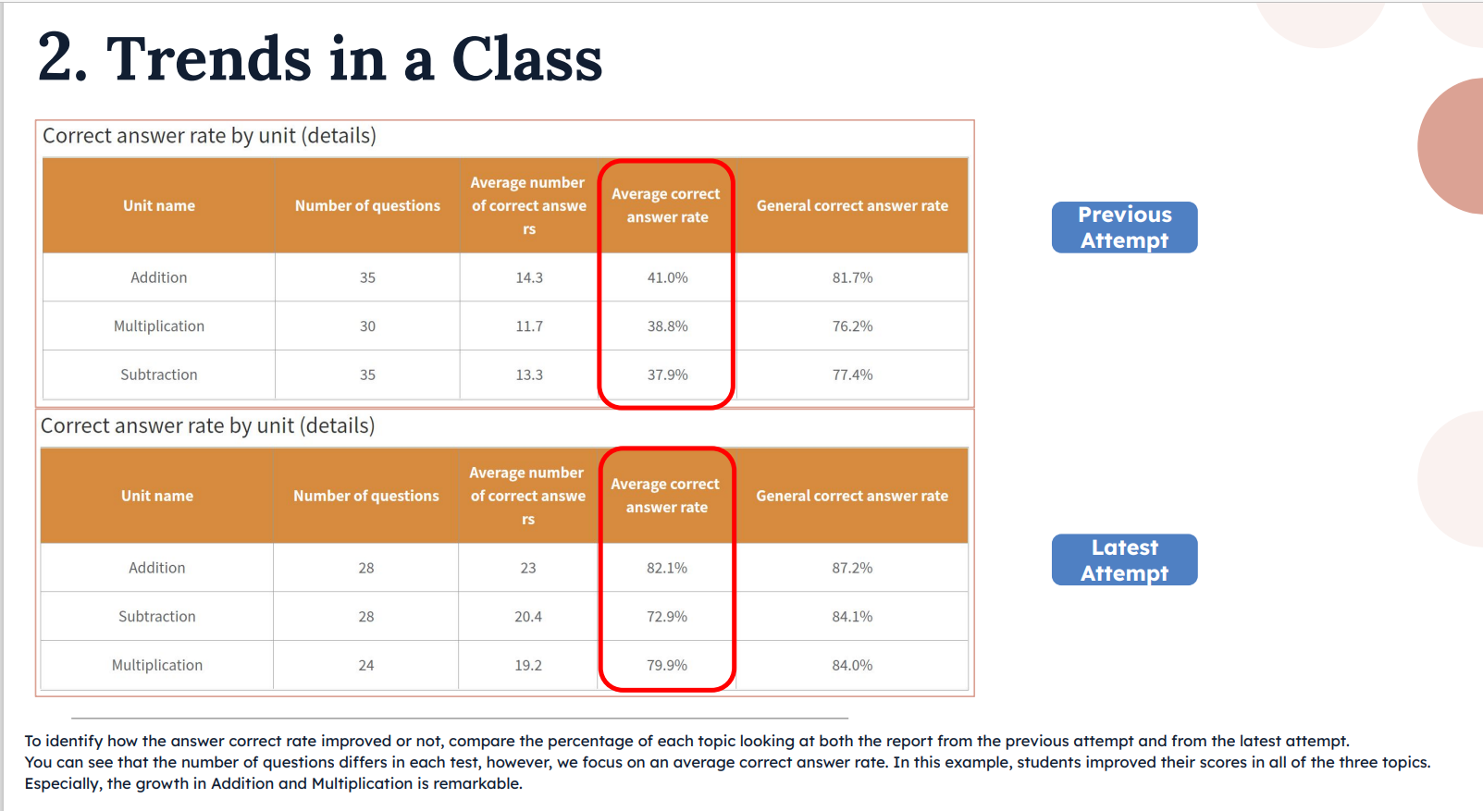

Slide 11
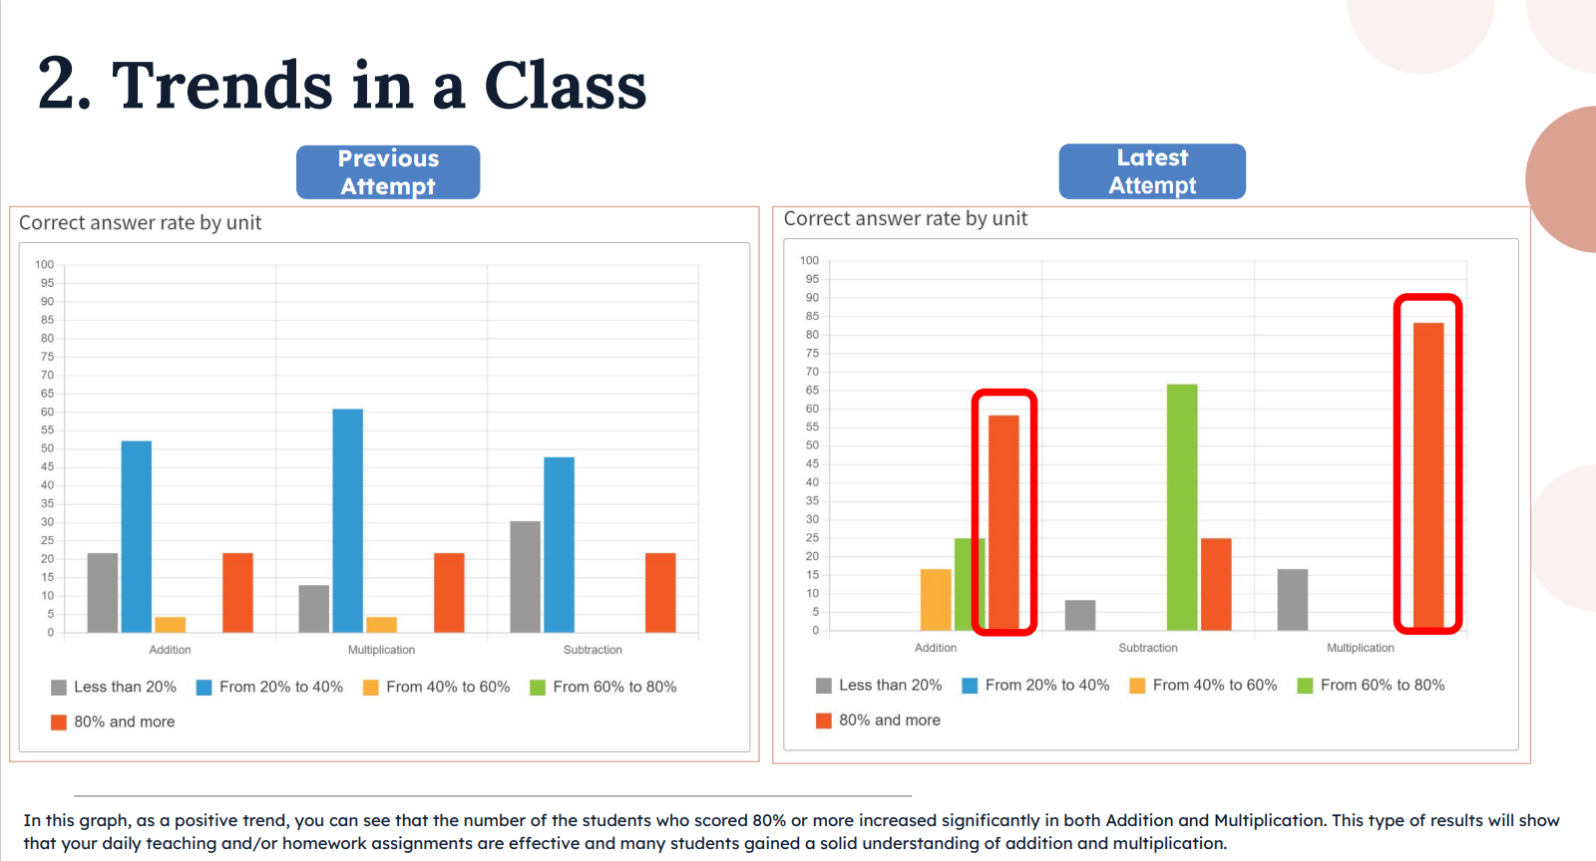

Slide 12
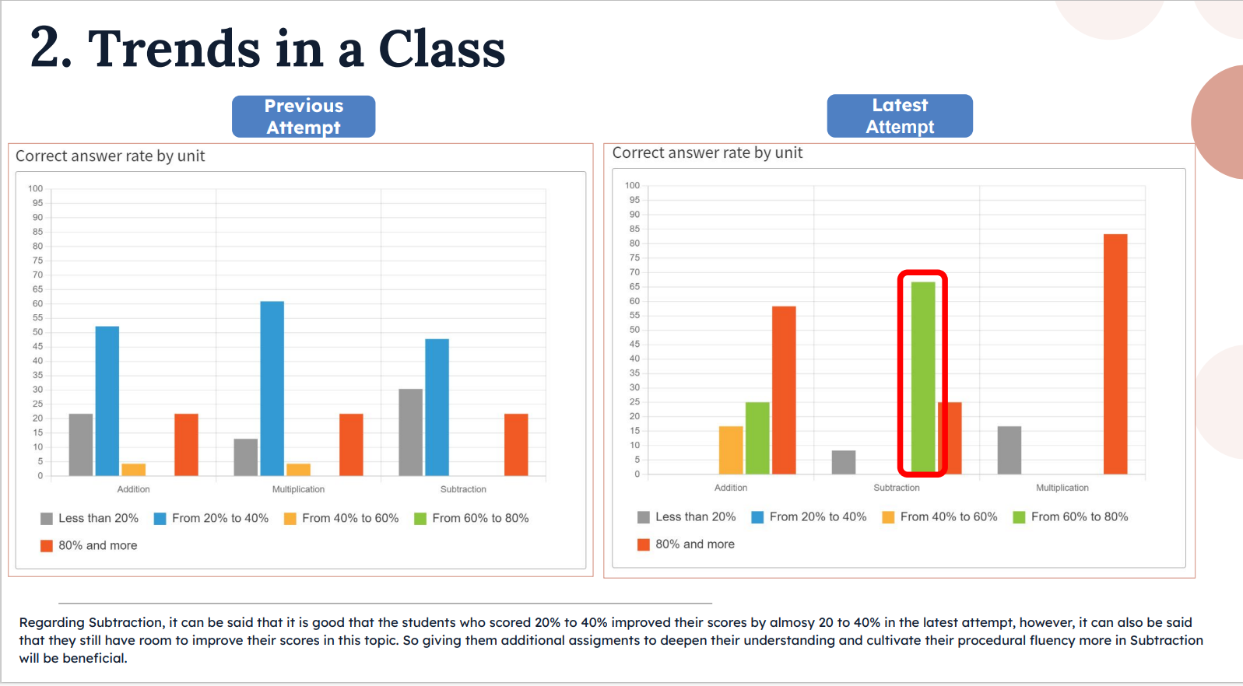

Slide 13
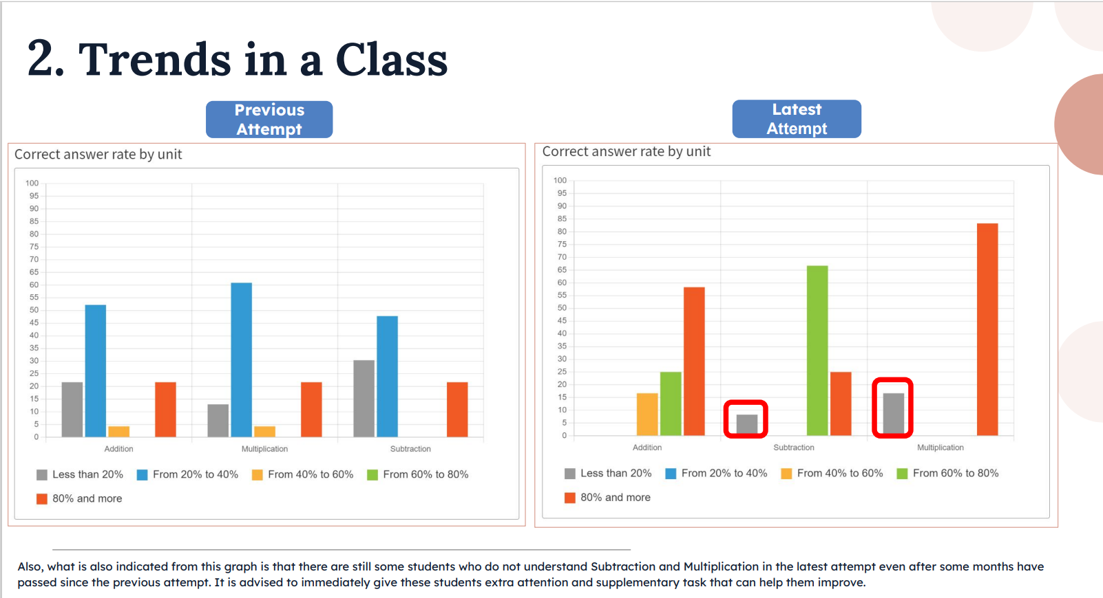

Slide 14
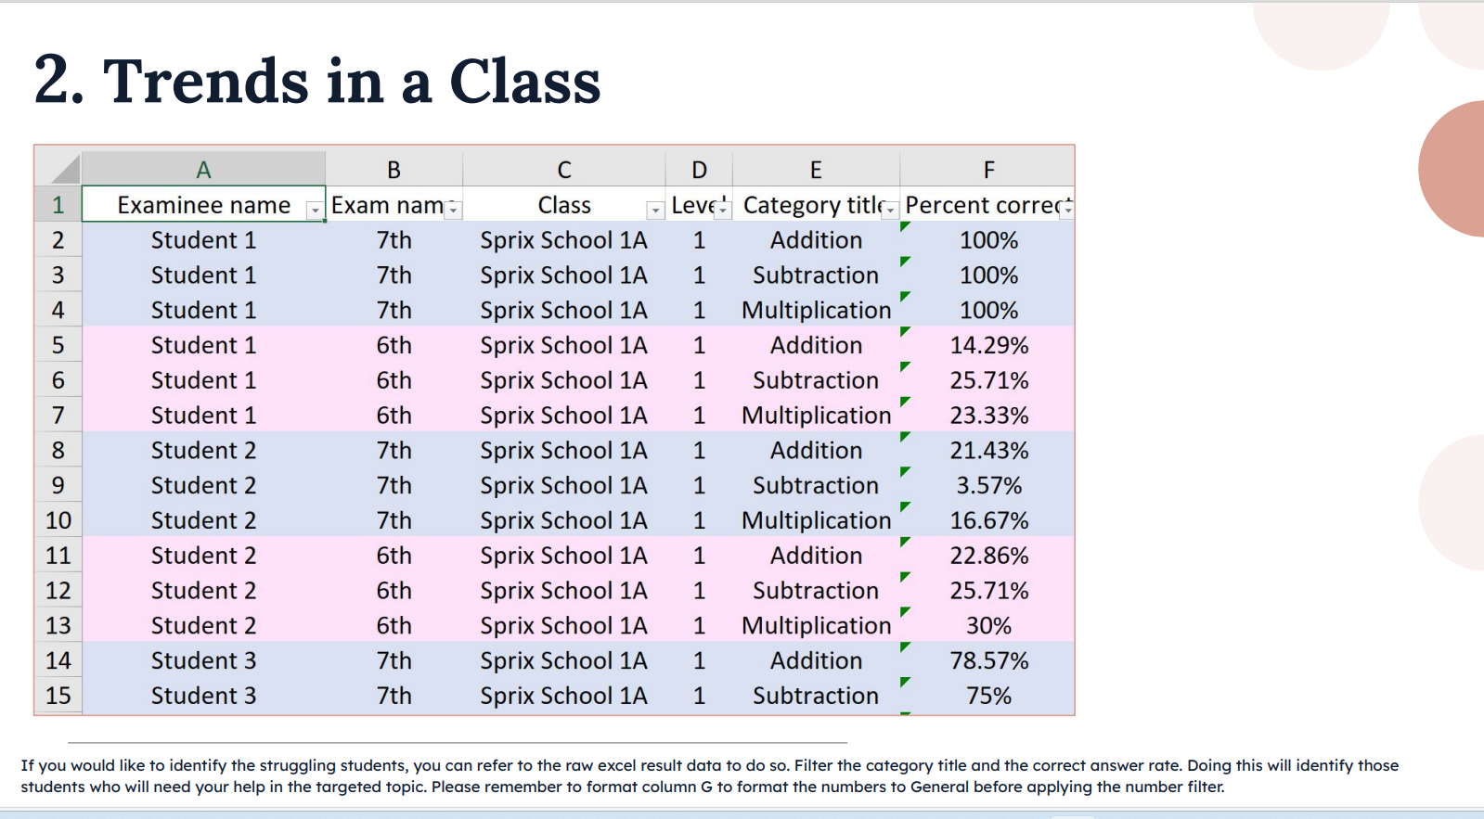

Slide 15
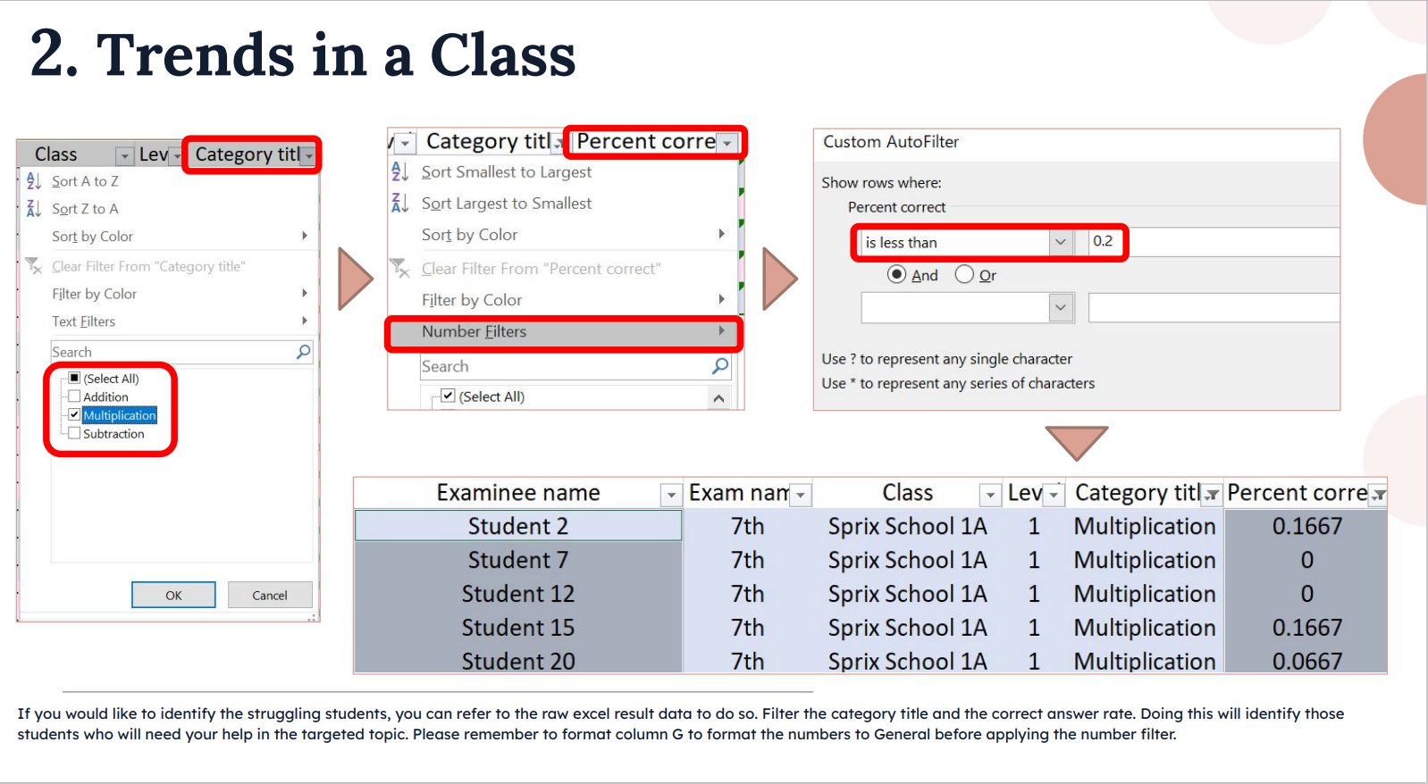

Slide 16
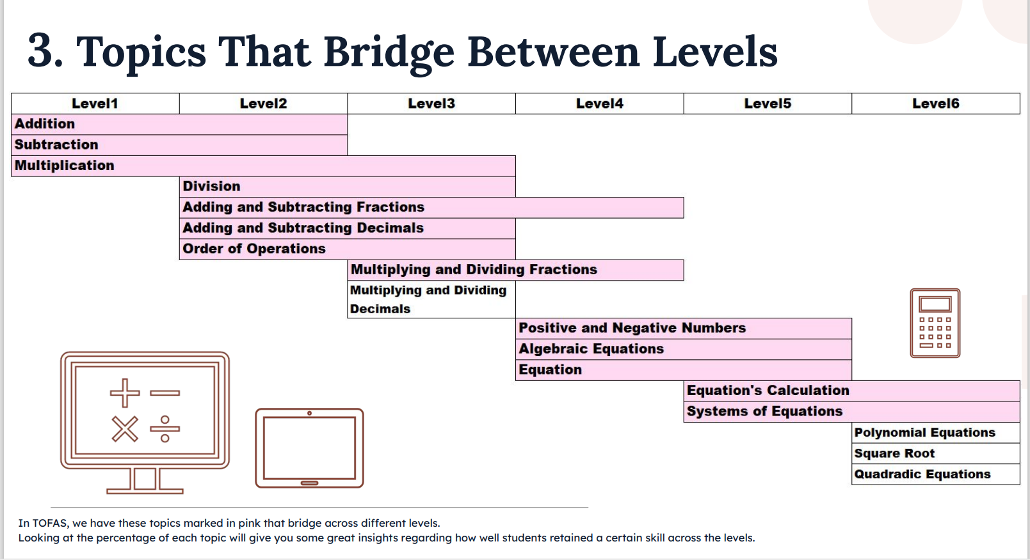

Slide 17
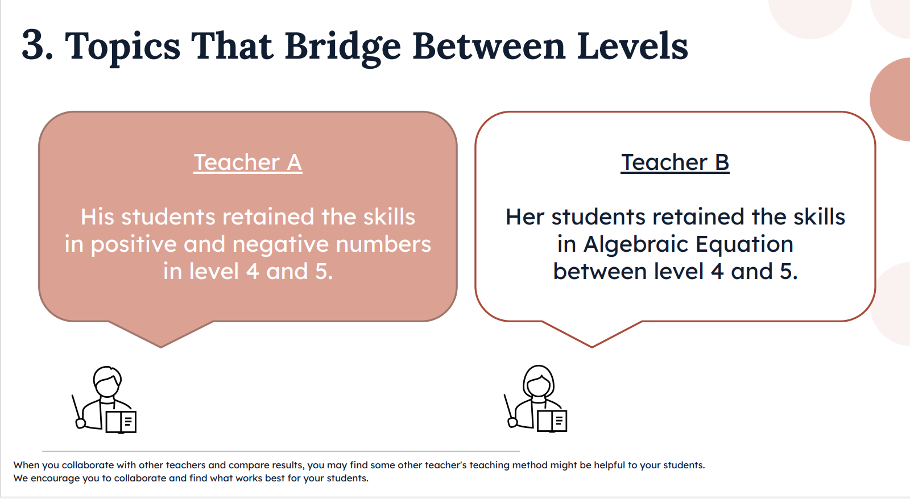

Slide 18
